Slide 1
Working of Topic Models

Slide 2
Setting Initial Parameters
Number of Topics, T = 2
Topics are: T_{o} and t₁
Gibbs Sampler iterations, gsIterations = 1000;
Stopping criteria for the inference technique i.e., Gibbs sampler
The distribution is expected to reach equilibrium in these iterations

Slide 3
Model’s hyper-parameters (Alpha & Beta)
Alpha = 1.0
Mixture of topics in documents
Beta = 0.1
Mixture of words in topics
Effect of different values for Alpha and Beta are discussed later

Slide 4
Variables (maintaining state of the model)
theta[d][t]
Distribution of a topic t in a document d
phi[t][w]
Distribution of a word w in a topic t
z[d][wo]
Label for a word occurrence wo in a document d

Slide 5
Constructor (Read Data)
Dictionary or Vocabulary = {bread, milk, chair}
Vocabulary size, V = 3
Assigning Unique IDs to words (tokens) to simplify
0 = bread
1 = milk
2 = chair
The documents are represented as,
D₀ = {0, 0, 0, 0, 0, 0, 0, 0, 0, 0}
D₁ = {1, 1, 1, 1, 1, 1, 1, 1, 1, 1}
D₂ = {2, 2, 2, 2, 2, 2, 2, 2, 2, 2}
D₃ = {0, 0, 0, 0, 0, 0, 0, 0, 0, 0,
1, 1, 1, 1, 1, 1, 1, 1, 1, 1}

Slide 6
Markov Chain Random Initialization
The inference technique used i.e., Gibbs sampler is a markov chain technique that has each state dependent on its previous state
The model is given an initial state at random by assigning topics t Є[0, T-1] to word occurrences docs[d][n] at random
N is the total number of words in a document that varies from doc to doc
For a word occurrence docs[d][n], its corresponding topic is stored in z[d][n]

Slide 7
Assuming the topics assigned to each in each document are:
For the following documents,
docs[0] = {0, 0, 0, 0, 0, 0, 0, 0, 0, 0}
docs[1] = {1, 1, 1, 1, 1, 1, 1, 1, 1, 1}
docs[2] = {2, 2, 2, 2, 2, 2, 2, 2, 2, 2}
docs[3] = {0, 0, 0, 0, 0, 0, 0, 0, 0, 0, 1, 1, 1, 1, 1, 1, 1, 1, 1, 1}
Lets assume the topics assigned to each of its word are,
Z[0] = {0, 0, 1, 1, 1, 0, 0, 0, 1, 1}
Z[1] = {1, 1, 0, 1, 1, 0, 0, 1, 1, 0}
Z[2] = {1, 0, 1, 0, 0, 0, 1, 1, 0, 0}
Z[3] = {1, 0, 0, 1, 1, 0, 1, 1, 0, 0, 1, 1, 1, 0, 1, 1, 0, 1, 1, 1}
E.g. the word occurrence docs[1][6] has unique word ID=1 and its topic Z[1][6]=0

Slide 8
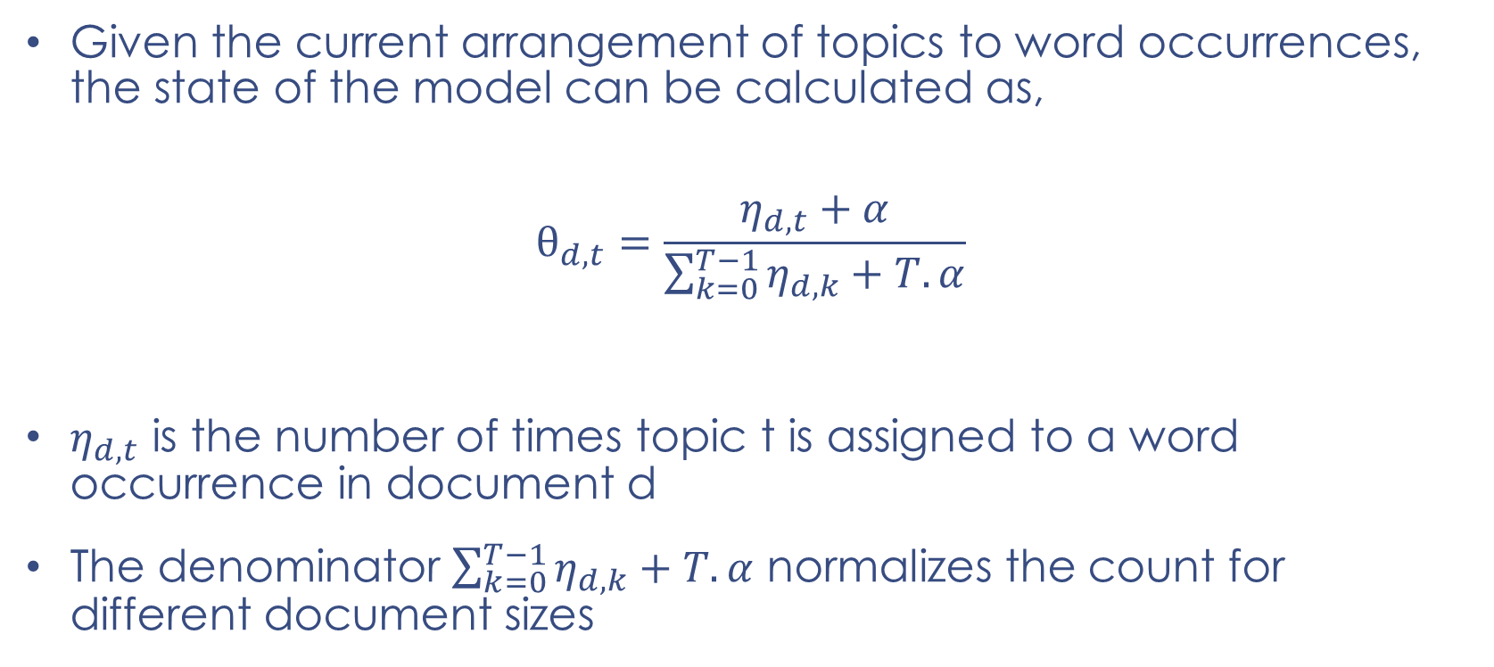
Model State ($θ$ and $φ$)
Given the current arrangement of topics to word occurrences, the state of the model can be calculated as,
$$θ_{d,t}=\frac{η_{d,t}+α}{\sum_{k=0}^{T−1}{η_{d,k}}+T.α}$$
$η_{d,t}$ is the number of times topic t is assigned to a word occurrence in document d
The denominator $\sum_{k=0}^{T−1}{η_{d,k}}+T.α$ normalizes the count for different document sizes

Slide 9
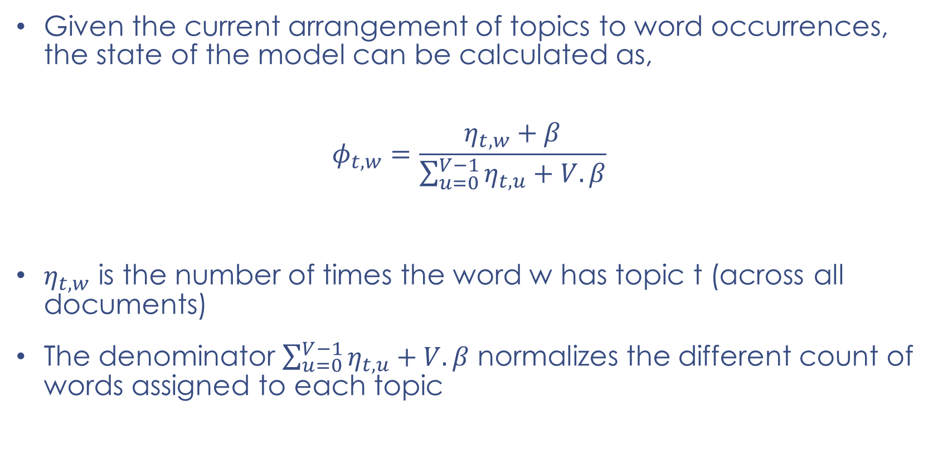
Model State ($θ$ and $φ$)
Given the current arrangement of topics to word occurrences, the state of the model can be calculated as,
$$φ_{t,w}=\frac{η_{t,w}+β}{\sum_{u=0}^{V−1}{η_{t,u}}+V.β}$$
$η_{t,w}$ is the number of times the word w has topic t (across all documents)
The denominator $\sum_{u=0}^{V−1}{η_{t,u}}+V.β$ normalizes the different count of words assigned to each topic

Slide 10

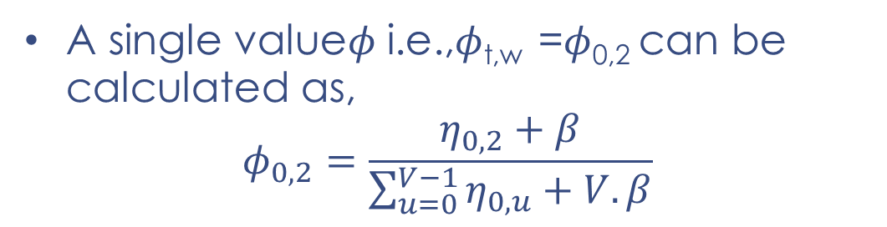

Model State ($θ$ and $φ$)
$θ$ is a D x T matrix, $φ$ is a T x V matrix
A single value $θ$ i.e., $θ$_{d,t} = $θ$_{2,0} can be calculated as,
$$θ_{2,0}=\frac{η_{2,0}+α}{\sum_{k=0}^{T−1}{η_{2,k}}+T.α}$$
Model State ($θ$ and $φ$)
A single value$φ$ i.e.,$φ$_{t,w} =$φ$_{0,2} can be calculated as,
$$φ_{0,2}=\frac{η_{0,2}+β}{\sum_{u=0}^{V−1}{η_{0,u}}+V.β}$$

